Slide 1
Mishmash Hackathon
Team Name ML_BUDDIES
Team Members Tamirisa Sai Krishna
Harish Kumar G
Theme Data Science POC Use Case
Github handles - https://github.com/harish21693
- https://github.com/ekrizaledu

Slide 2
Problem Statement 3 - Data Science POC Use Case
One of Unilever’s brands is going through some major changes in Business Execution plans and will like to know:
What are the major drivers for sales(EQ)?
Knowing the drivers, how can they predict future sales for the next 6 periods?

Slide 3
Data understanding and observation
1. The input file consisted of about 12000 records , few columns had null values which were imputed with median.
2. All of the columns except period, are numeric in nature.
3. EQ is dependent variable which needs to be predicted using other variables.
4. EDA was performed by plotting scatter plots for EQ against other predictor variables.

Slide 4
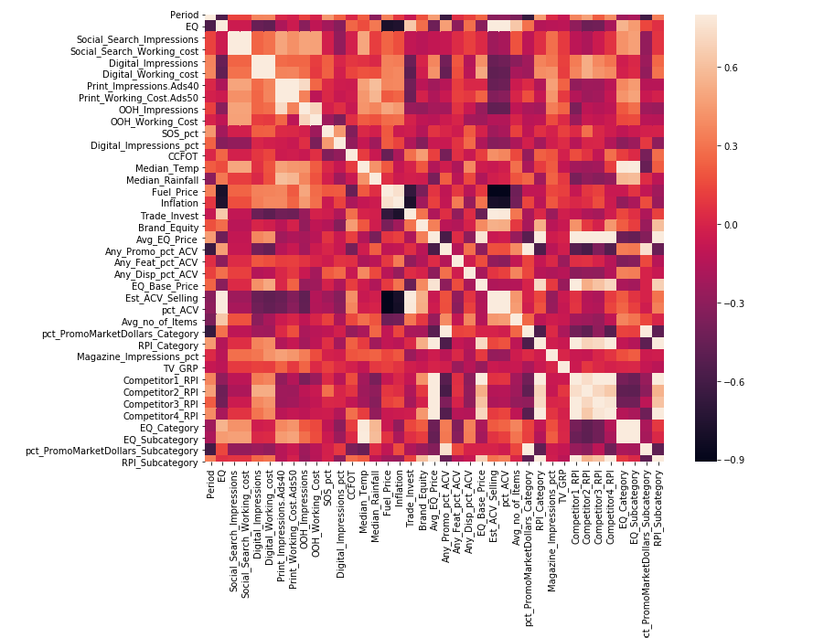
Correlation Plot

Slide 5
Data understanding and observation
5. In correlation matrix, it can be seen that EQ is dependent on estimated volume of the market, Commodity volume , Trade Invest , EQ category and subcategory
6. Then scaling was carried out as the variables were in different scale by following standardization
7.Then data was split as train and test as (0.8 to 0.2 ratio)
8. Recursive feature elimination was used to pick the top 15 variables/predictors

Slide 6
Data understanding and observation
9. Then features were dropped based on pvalue and variance inflation factor until all were in acceptable range.
10. It was seen that the Rsquare using linear regression was very high and it seemed our model was predicting well , as our test r square was also significantly high.
11. The final drivers derived were 'Fuel_Price', 'Inflation', 'TV_GRP', 'EQ_Category', 'Period‘ . These were used for final prediction for given test data.

